Slide 1




Slide 2
Day 2 (04/11): Filtering Data with WHERE Clause
🎯 Objective
Learn how to filter rows from a table using conditions to display only relevant data.
🔍 Topics Covered
WHERE Clause
OPERATORS USED WITH WHERE CLAUSE
-- COMPARISON OPERATORS
-- LOGICAL OPERATORS
-- RANGE OPERATOR
-- MEMBERSHIP OPERATOR
-- SEARCH OPERATOR
-- NULLABILITY OPERATOR

Slide 3
WHERE Clause
The WHERE clause in SQL is used to filter records. It is used to specify a condition so that only those rows that meet the condition are returned.
SYNTAX
SELECT
column1, column2, ...
FROM table_name
WHERE condition;
SYNTAX
SELECT *
FROM table_name
WHERE condition;

Slide 4
OPERATORS USED WITH WHERE CLAUSE
In MySQL, operators used with the WHERE clause help filter rows based on specific conditions. These operators are classified into the following categories:
COMPARISON OPERATORS
RANGE OPERATOR
LOGICAL OPERATORS
MEMBERSHIP OPERATOR
SEARCH OPERATOR
NULLABILITY OPERATOR
=
<> , !=
>
>=
<
<=
AND
OR
NOT
IN
NOT IN
LIKE
NOT LIKE
IS NULL
IS NOT NULL
BETWEEN

Slide 5
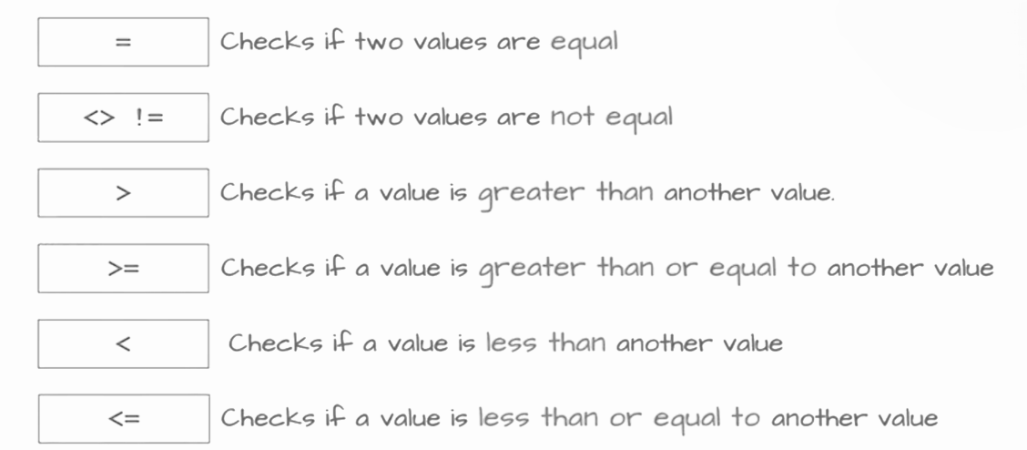
COMPARISON OPERATORS
Comparison operators in SQL are used to compare one value with another in a query condition. They help determine which rows from a table match specific criteria — for example, finding values greater than, less than, or equal to a certain number.

Slide 6
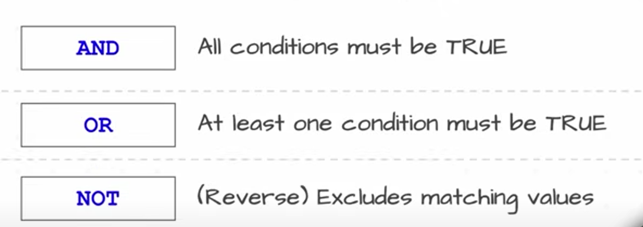
LOGICAL OPERATORS
Logical operators are used in SQL to join two or more conditions. They return rows only if the combined condition is true.

Slide 7
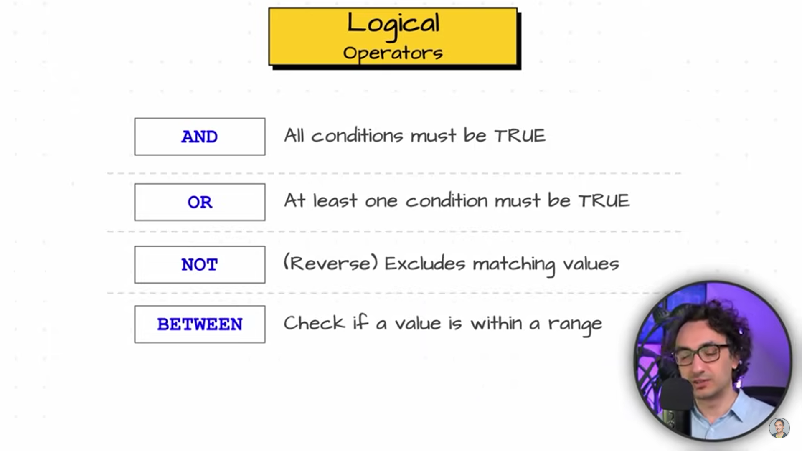
RANGE OPERATOR
BETWEEN OPERATOR :-
The BETWEEN operator is used to filter values within a specific range
(inclusive of the start and end values).
It works with numbers, dates, or text.
SELECT column_name
FROM table_name
WHERE column_name BETWEEN value1 AND value2;
Syntax :-

Slide 8
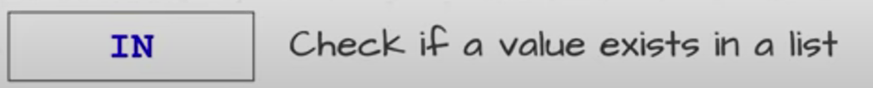
MEMBERSHIP OPERATORS
IN OPERATOR :-
The IN operator is used to check if a value matches any value in a given list.
SELECT column_name
FROM table_name
WHERE column_name IN (value1, value2, value3, ...);
Syntax :-

Slide 9
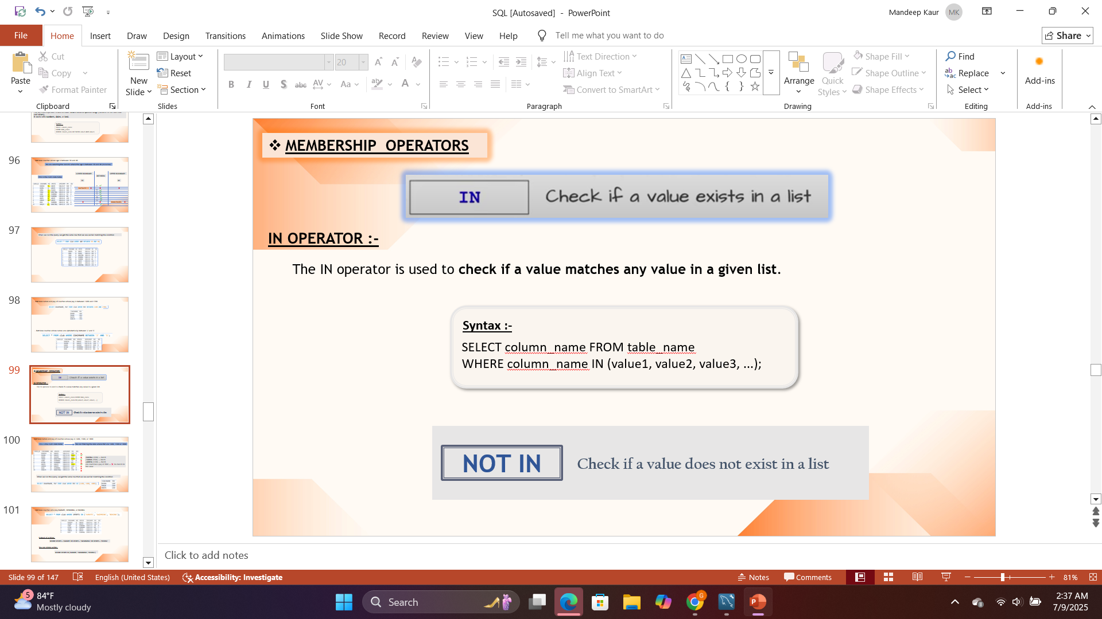
NOT IN OPERATOR :-
The NOT IN operator is used to filter the records where a value is not present in a given list of values. It is the opposite of the IN operator.
SELECT column1, column2, ...
FROM table_name
WHERE column_name NOT IN (value1, value2, ...);
Syntax :-

Slide 10
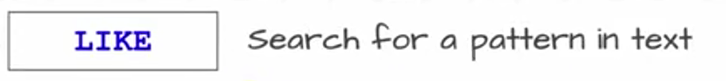
SEARCH OPERATORS
LIKE Operator
The LIKE operator in SQL is used to search for values that match a specific pattern in a text column, such as names, cities, or sports.
The LIKE operator uses special wildcard characters —
% represents any number of characters
_ represents a single character
This makes it useful for finding text that starts with, ends with, or contains certain letters or patterns.
SELECT column_name
FROM table_name
WHERE column_name LIKE 'pattern';
Syntax :-

Slide 11
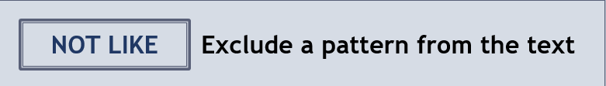
NOT LIKE Operator
The NOT LIKE operator is used to exclude rows that match a certain pattern. It returns rows where the pattern does not match.
It is the opposite of the LIKE operator.
SELECT column_name
FROM table_name
WHERE column_name NOT LIKE 'pattern';
Syntax :-

Slide 12
NULLABILITY OPERATORS
IS NULL / IS NOT NULL
IS NULL is used to check if a column has no value (i.e., it is empty or undefined).
IS NOT NULL checks if a column has some value (i.e., it is not empty).
You cannot use = NULL or != NULL — instead, use IS NULL or IS NOT NULL.
SELECT column_name
FROM table_name
WHERE column_name IS NULL;
SELECT column_name
FROM table_name
WHERE column_name IS NOT NULL;
Syntax :-

Slide 13


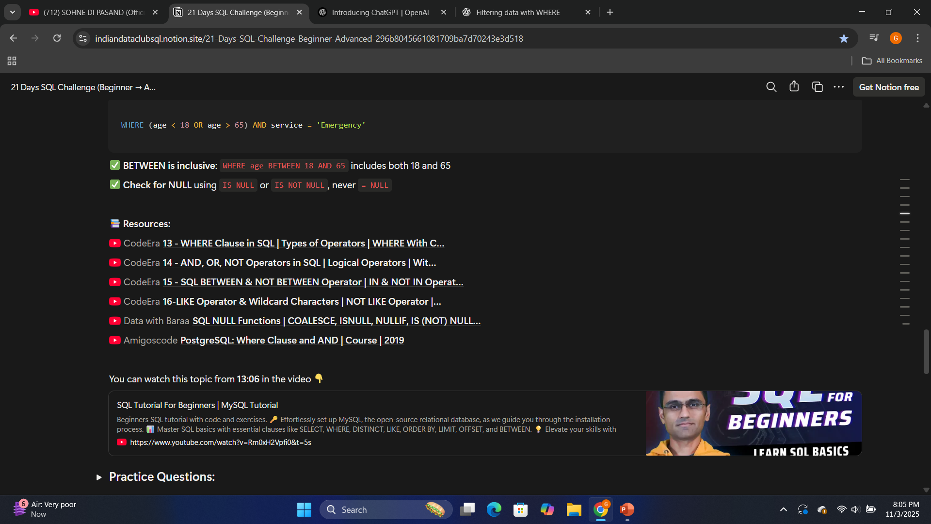
📚 Resources:

Slide 14
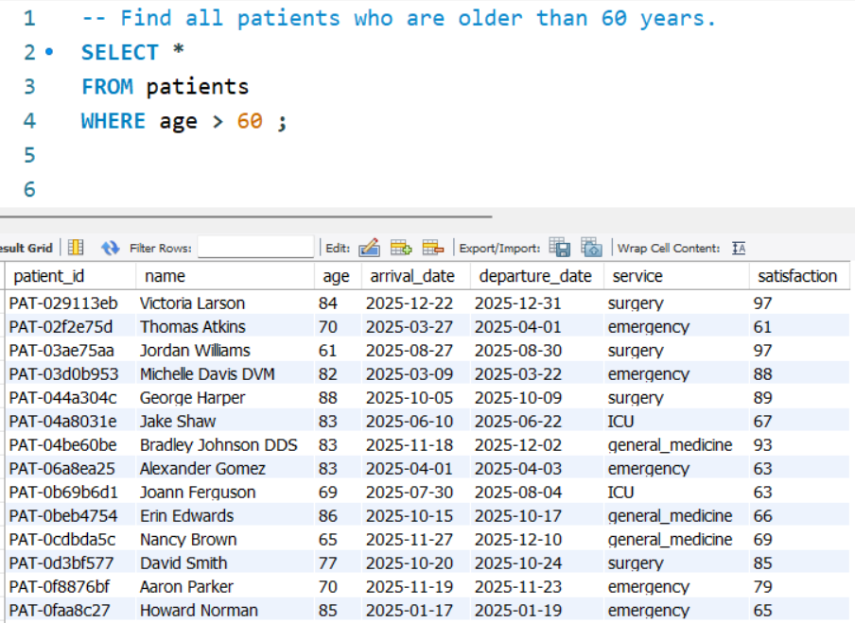
Practice Questions:
SELECT * → Gets all columns from the table. FROM patients → Chooses the data source table. WHERE age > 60 → Shows only patients older than 60.

Slide 15
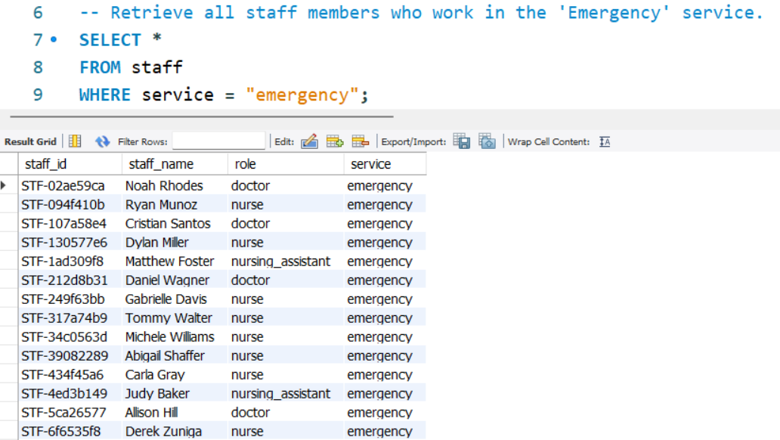
Practice Questions:
SELECT* → Gets all columns from the table. FROM staff → Chooses the table to fetch data from. WHERE service = "emergency" → Shows only staff working in the emergency service.

Slide 16
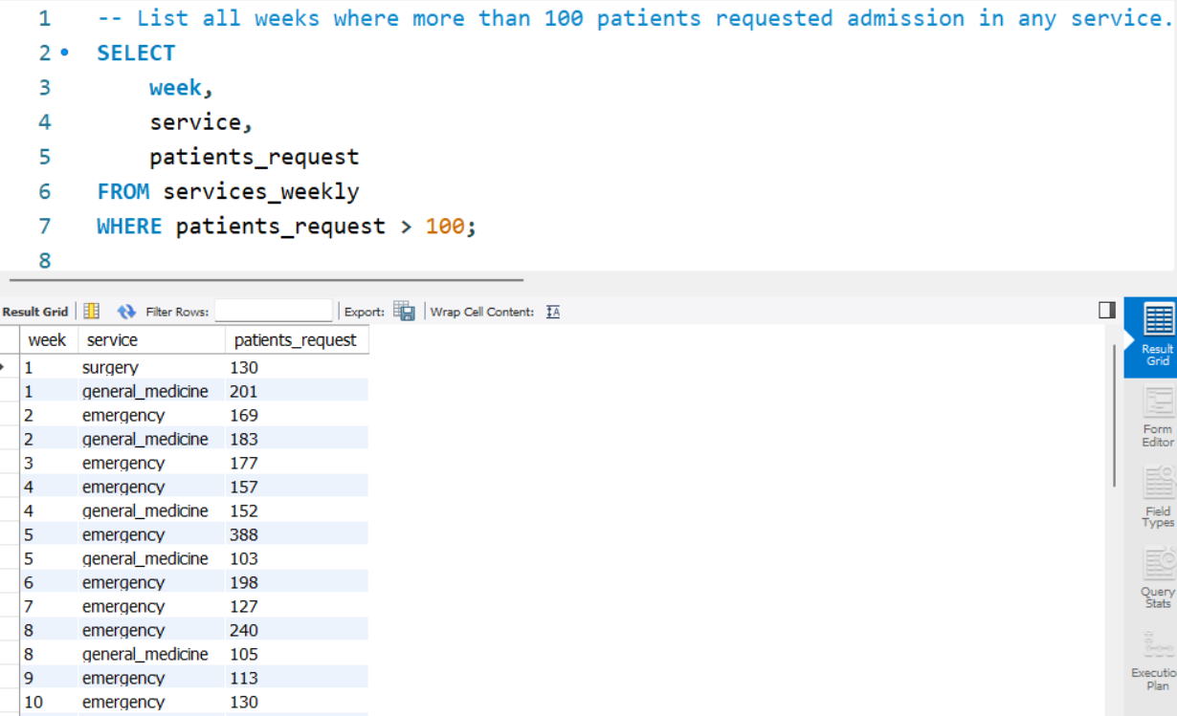
Practice Questions:
SELECT → Chooses specific columns to display. FROM services_weekly → Gets data from this table. WHERE patients_request > 100 → Shows only weeks with over 100 patient requests.

Slide 17
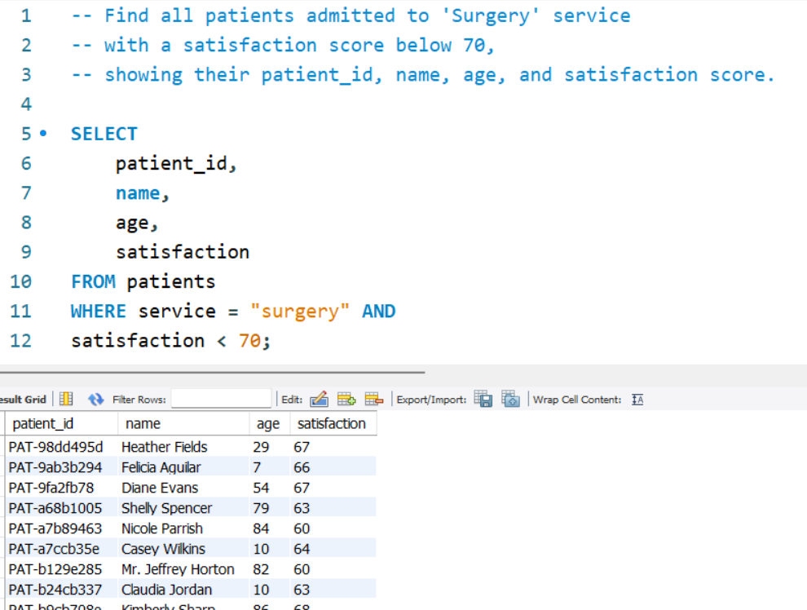
Daily Challenge:
SELECT → Chooses specific columns to display. FROM patients → Gets data from the patients table. WHERE service = "surgery" AND satisfaction < 70 → Shows surgery patients with satisfaction scores below 70.

